Slide 1


Kidth;.f.nry;tp
Jiwj;jiyth; & ,izg;Nguhrphpah;
rPjhyl;Rkp ,uhkRthkp fy;Y}hp
jpUr;rpuhg;gs;sp
“vd; fy;Y}hp vd; ngUik”
Kidth; f. nry;tp
jiyth; & ,izg;Nguhrphpah;
jkpo;j;Jiw

Slide 2
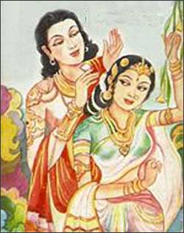
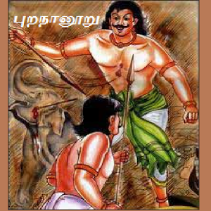
rq;f ,yf;fpak;
;
mfg;ghly; Gwg;ghly;

Slide 3
vl;Lj;njhif
mfk; gw;wpait Gwk; gw;wpait
1. ew;wpiz 1. GwehD}W
2. FWe;njhif 2. gjpw;Wg;gj;J
3. Iq;FWE}W
4. mfehD}W
5. fypj;njhif
mfk; Gwk; gw;wpaJ
1. ghpghly;

Slide 4
vl;Lj;njhif - GwehD}W
Gwg;nghUs; gw;wpa 400 ghly;fs; cilaJ
toq;fg;ngWk;; ngah;fs; 1. Gwg;ghl;L
2. Gwk;
3. Gwk;G ehD}W
rpwg;G : goe;jkpo; kf;fspd; tho;tpay;>
kd;dhpd; tPuk;> nfhil gw;wp
vLj;Jiuj;jy;

Slide 5


‘ahJ %Nu ahtUq; Nfsph;
jPJ ed;Wk; gpwh;ju thuh
NehjYe; jzpjY ktw;Nwh ud;d
rhjYk; GJt jd;Nw tho;jy;
,dpnjd kfpo;e;jd;W kpyNk Kdptpd;
,d;dh njd;wY kpyNk kpd;ndhL
thde; jz;Lsp jiy, ahdhJ
fy;nghU jpuq;F ky;yw; Ngh;ahw;W
ePh;topg; g^ck; GizNgh yhUaph;
Kiwtopg; g^c nkd;gJ jpwNthh;
fhl;rpapw; nwspe;jd khfypd; khl;rpapw;
nghpNahiu tpaj;jY kpyNk
rpwpNahiu apfo;j yjdpD kpyNk”

Slide 6
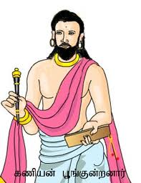
jpiz: nghJtpay; jpiz
gpw jpizfspy; $whJ tplg;gl;l
nghJthd fUj;Jfisf; $WtJ.
Jiw: nghUz;nkhopf;fhQ;rp
tho;tpd; epiyahikia
typAWj;JtJ.
Mrphpah;: fzpad; G+q;Fd;wd;
g+q;Fd;wk; (Ch;)
md;W -g+q;Fd;wk; ,d;W - ,uhkehjGu
khtl;lk;
kfpghyd;gl;b> Flfkiy

Slide 7
ghlypd; nghUs;;
vkf;F vy;yh CUk; nrhe;j Ch;
vy;yhUk; vk; Rw;wj;jhh;
,d;gk;> Jd;gk; gpwh; ju tuhJ jk;khy; tUtd
ePh;topNa njg;gKk;; Co;topNa capUk; nry;Yk;
ed;ikiag; ghuhl;lYk;> jPikia ntWj;jYk;
,yh;
nka;awpe;Njhh; fz;l cz;ik newp

Slide 8
vf;fhyj;jpw;Fk; chpa fUj;Jf;fs;
jdpkdpj mikjp
gpwiuf; Fw;wk; $whik
rkNehf;F rpe;jid
kdpjNeak;
xUikg;ghl;Lzh;T
cyfj;jhh; Vw;Fk; cd;dj newpfs;

Slide 9

ed;wp

