Slide 1
Mrs. R.SAKTHI
ASSOCIATE PROFESSOR
DEPARTMENT OF NUTRITION AND DIETETICS
SEETHALAKSHMI RAMASWAMI COLLEGE
TRICHY-2

Slide 2
FOOD STANDARDS

Slide 3
FOOD STANDARDS
Ensures quality and safety of natural and processed foods.
Have been formulated and enforced by Law.
An International body was established – Codex Alimentaires Commission(CAC)
Objectives of this body – To develop International and Regional Food standards and publish them as food Code.

Slide 4
The PFA has laid down standard specifications for the following groups of food products and food additives.
Milk, ghee, butter, khoa and dahi.
Edible oils and fats including vanaspathi and margarine.
Tea, coffee, cocoa and chicory.
Wheat flour, cereals, pulses, semolina and sago.
Bread, biscuits, pastries and allied products.
Fruit and vegetable products and non-alcoholic beverages.
Sugar, jaggery, honey and syrup.
Confectionery, sweetmeats, chocolate and toffee.
Custard powder, corn flakes,
Baby food and milk powder, condensed milk and cheese.
Spices and condiments.
Food additives, flavouring agents, antioxidants, edible colours, emulsifying and stabilizing agents, preservatives, artificial sweeteners, permitted in food products.

Slide 5
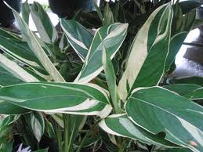
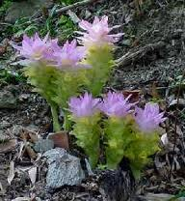
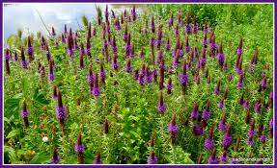
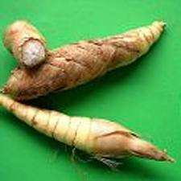
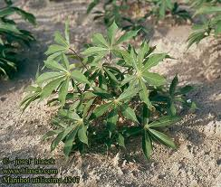
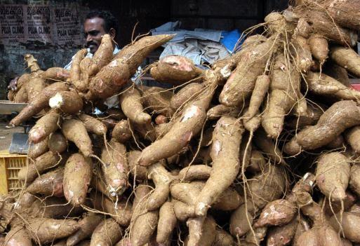
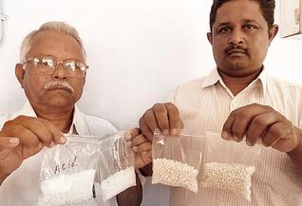
STARCHY FOODS – ARROWROOT STARCH, SAGO
Maranta
arundinacea
Curcuma angustifolia
Indian Arrowroot –
Curcumaangustifol​ia
Arrowroot
Arrowroot starch – seperated and purified starch from the above rhizomes.
Sago – small hard globules/pearls made from starch of these plants.
Manihot utilissima
tapioca
sago
STANDARDS FOR SAGO
Shall be free from any extraneous matter (including natural colours).
Total ash (on dry basis) – not more than) – shall not exceed 0.1% 0.4%
Ash insoluble in dilute HCl (on dry basis

Slide 6
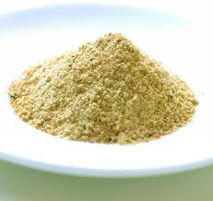
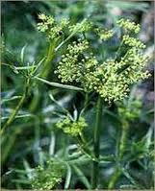
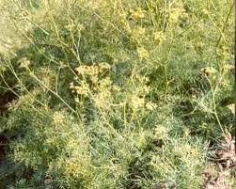
SPICES AND CONDIMENTS
ASAFOETIDA (Hing or Hingra)
ASAFOETIDA
Ferula rubricaulis
Hing plant
Asafoetida – Oleo – gum resin obtained from the rhizome and roots of the above species.
STANDARDS FOR HING AND HINGRA
Criteria | Hing | Hingra
Total ash content (shall not exceed) | 15% by weight | 20% by weight
Ash insoluble in dil.HCl (shall not exceed) | 2.5% by weight | 8% by weight
Alcoholic extract(with 90% alcohol) (USP method) (shall not be less than) | 12% | 50%
Starch (shall not exceed) | 1% by weight | 1% by weight

Slide 7
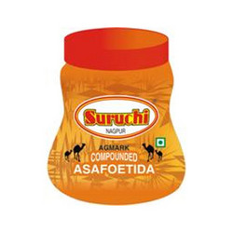
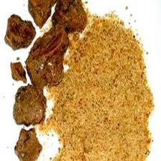
COMPOUNDED ASAFOETIDA OR BANDHANI HING
Compounded
asafoetida
Bandhani Hing
Composed of one or more varieties of asafoetida and gum arabic, atta or rice flour or both.
It shall not contain
Colophony resin
Galbonum resin
Ammonia cum – resin
Any other foreign resin
Coal – tar dyes
Mineral pigment
More than 10% total ash content
More than 1.5% ash insoluble in dil.HCl
Less than 5% alcoholic extract (USP method)

Slide 8
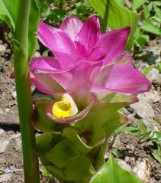
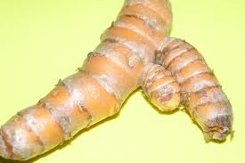
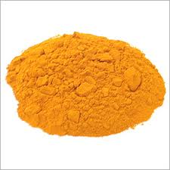
TURMERIC (HALDI)
Dried rhizome or bulbous roots of this plant
Shall be free from lead chromate .
No other artificial colouring matter.
Proportion of extraneos matter – shall not exceed 2% by weight.
Curcuma longa
Turmeric
Powder obtained by grinding the dried rhizomes or bulbous roots.
Free from artificial colouring matter.
Turmeric Powder
SPECIFICATIONS FOR TURMERIC POWDER
Moisture – not more than 13% by weight.
Total ash – not more than 9% by weight.
Ash insoluble in dilute HCl – not more than 1.5% by weight.
Test for lead chromate – Negative.
Total starch – not more than 60% by weight.

Slide 9
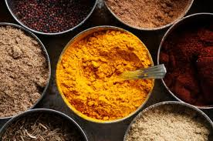
CURRY POWDER
Curry powder
Powder obtained from grinding clean, dried and sound apices of aromatic herbs and seeds such as black pepper, cinnamon, cloves, coriander, cardamom, chillier, cumin seeds fenugreek, garlic, ginger, mustard, poppy seeds, turmeric, mace, nutmeg, curry leaves, white pepper, saffron and aniseeds.
Contain added starch and edible common salt.
Proportion of spices - Shall be not less than 58% by weight.
Free from dirt, mould growth and insect infestation.
Shall be free from any added colouring matter and preservatives.
SPECIFICATIONS
Moisture - not more than 14% by weight.
Volatile oil – not less than 0.25% on dry basis.
Non – volatile ether extract – not less than 7.5% by weight on dry basis.
Edible common salt – not more than 5% by dry weight on dry basis.
Ash insoluble in dil.HCl – not more than 2% by weight on dry basis.
Crude fibre – Not more than 15% by weight on dry basis.
Lead – Not more than 10 ppm on dry basis.

Slide 10
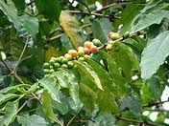
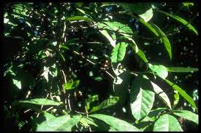
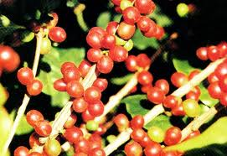
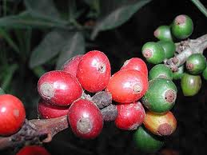
COFFEE
Coffea Arabica
Coffea liberica
Robusta coffee
Coffea Excelsa
Coffee means the seed of the above plants.
Freed from all but a small portion of its spermoderm by decortication.
Roasted coffee – Properly cleaned green coffee which has been roasted to a brown colour , developed its characteristic aroma.
Ground coffee – Powdered product obtained from roasted coffee, free from husk.
STANDARDS
Total ash – not less than 3.5% and not more than 5% by weight.
Ash insoluble in hot dil.HCl – not more than 0.1%.
Alkalinity of the ash per gram – not less than 3.4ml and not more than 4.4ml of N/10 acid.
Aqueous extract – not less than 25% and not more than 32%.

Slide 11
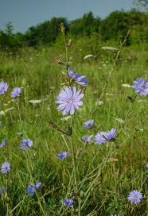
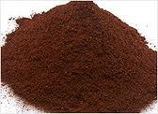
CHICORY
Roasted chicory powder obtained by roasting the cleaned and dried roots of the plant.
With or without addition of edible fats and oils or sugar like glucose or sucrose in proportion not exceeding 2% by weight.
Free from artificial colouring and flavouring matter.
Cichorium intybus
Chicory Powder
STANDARDS
Total ash – not less than 3.5% and not more than 10%.
Ash insoluble in dil.HCl – not more than 2.5% on dry basis.
Water soluble matter – Not less than 50% on dry basis.
COFFEE – CHICORY MIXTURE
Pure ground coffee mixed with roasted and ground chicory.
No rancid or obnoxious flavour.
Caffeine – not less than 0.6%.
Aqueous extract – not more than 50%.

Slide 12
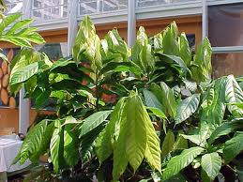
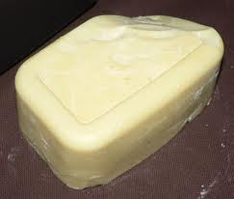
COCOA BUTTER
Theobroma cacao
Cocoa butter
Fat obtained by expression from the nibs of this plant.
Free from other oils, fats, mineral oil and added colours.
STANDARDS
Free fatty acid(oleic acid) – not more than 1.5%.
Iodine value – 32-42
Melting point – 29oC-34oC.
Butyro refractometer reading at 40oC – 40.9 to 48.0.
Saponification value – 185 to 200.

Slide 13
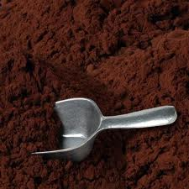
COCOA POWDER
Powder which is the partially defatted product derived from the cocoa bean.
Free from rancidity, dirt, filth, insect fragments or fungus infestations.
STANDARDS (on moisture and fat free basis)
Total ash – not more than 14%
Ash insoluble in dil.HCl – not more than 1%
Alkalinity of total ash – not more than 6%

Slide 14
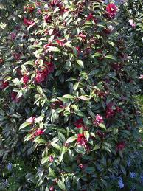
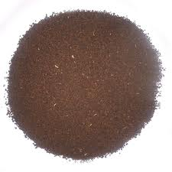
camellia
TEA
Powder Tea
Derived from exclusively from the leaves, buds and tender stems of the plant.
SPECIFICATIONS
Total ash – 5 to 8%.
Total ash soluble in boiling distilled water – not less than 40% of total ash.
Ash insoluble in HCl – not more than 1%.
Alkalinity of soluble ash – not less than 1% and not more than 2.2%.
Crude fibre – not more than 17%.
Shall not contain any added colouring matter.

Slide 15
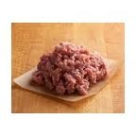
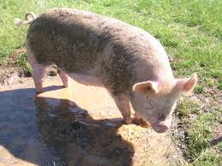
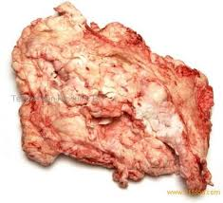
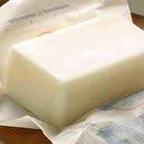
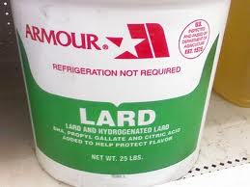
FATS AND OILS
ANIMAL FATS
Beef Fat
Goat Fat
Lard
Hogs
Beef fat or suet – Fat obtained from a beef carcass.
Goat fat – rendered fat from goat.
Lard – Rendered fat from hogs.
Criteria | Saponification value | Iodine value
Beef fat | 193- 200 | 35 - 46
Goat fat | 193 – 196 | 36 - 45
Lard | 192 – 198 | 52 - 65

Slide 16
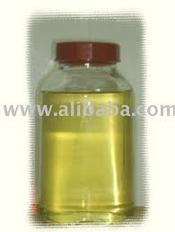
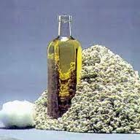
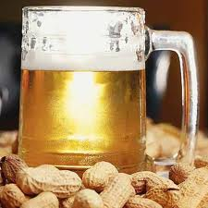
VEGETABLE OILS
Buryro refractometer reading | Saponification value (not less than) | Iodine value | Free fatty acid(as oleic acid)(not more than)
34.0 – 35.5 | 250 | 7.5 – 10.0 | 3.0%
Coconut Oil
Buryro refractometer reading | Saponification value (not less than) | Iodine value | Free fatty acid(as oleic acid)(not more than)
57.9 – 60.2 | 190 – 198 | 98 – 112 | 1.0%
Cotton Seed Oil
Buryro refractometer reading | Saponification value (not less than) | Iodine value | Free fatty acid(as oleic acid)(not more than)
54.0 – 57.1 | 188 – 196 | 85 – 99 | 3.0%
groundnut oil

Slide 17
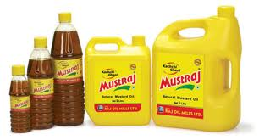
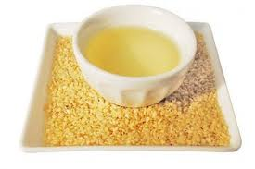
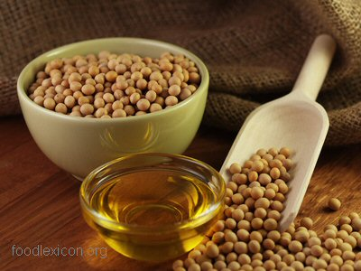
Buryro refractometer reading | Saponification value (not less than) | Iodine value | Free fatty acid(as oleic acid)(not more than)
58.0 – 60.5 | 168 – 177 | 96 – 108 | 3.0%
Mustard Oil
Buryro refractometer reading | Saponification value (not less than) | Iodine value | Free fatty acid(as oleic acid)(not more than)
6.5 – 65.4 | 185 – 190 | 115 – 120 | 3.0%
sesameseed oil
Buryro refractometer reading | Saponification value (not less than) | Iodine value | Free fatty acid(as oleic acid)(not more than)
61.7 – 69.5 | 189 – 195 | 120 – 141 | 1.25%
Soybean oil

Slide 18
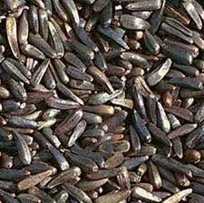
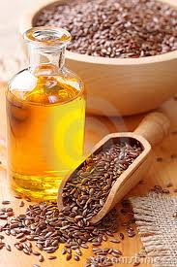
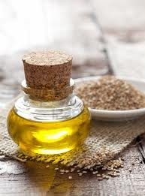
Buryro refractometer reading | Saponification value (not less than) | Iodine value | Free fatty acid(as oleic acid)(not more than)
61.0 – 65.0 | 185 – 193 | 125 – 135 | 3.0%
Niger Seeds
Buryro refractometer reading | Saponification value (not less than) | Iodine value | Free fatty acid(as oleic acid)(not more than)
69.5 – 74.3 | 188 – 195 | >170 | 2.0%
Linseed oil
Buryro refractometer reading | Saponification value (not less than) | Iodine value | Free fatty acid(as oleic acid)(not more than)
49.5 – 52.7 | 187 – 196 | 58 – 70 | 2.0%
(mahua)oil

Slide 19
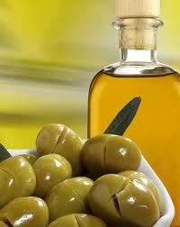
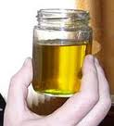
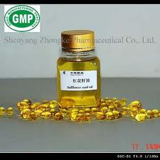
Buryro refractometer reading | Saponification value (not less than) | Iodine value | Free fatty acid(as oleic acid)(not more than)
53.0 – 56.0 | 185 – 196 | 79 – 90 | 3.0%
Olive oil
Buryro refractometer reading | Saponification value (not less than) | Iodine value | Free fatty acid(as oleic acid)(not more than)
60.0 – 64.0 | 186 – 194 | 133 – 146 | 3.0%
Poppy Seed Oil
Buryro refractometer reading | Saponification value (not less than) | Iodine value | Free fatty acid(as oleic acid)(not more than)
62.4 – 64.7 | 186 – 196 | 135 – 146 | 3.0%
Safflowerseed oil

Slide 20
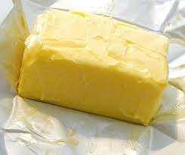
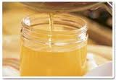
MARGARINE
Edible oils – 80% ; Moisture – 16%; Til oil – not less than 5%
Prepared with or without edible common salt.
Free from rancidity, colouring flavouring substances, mineral oil or animal fat.
Vitamin A – not less than 25I.U./gm.
May contain permitted emulsifying and stabilising agents.
VANASPATHI
Refined edible vegetable oil or oils.
Prepared by hydrogenation from ground oil, cottonsed oil and sesame oil or mixtures.
STANDARDS
No harmful colouring, flavouring, deleterious matter.
No colour or flavour resembling ghee colour.
Moisture – not more than 0.25% ; Melting point – 31oC to 37oC; Free fatty acid – 0.25%
Contain raw or refined sesame(til) oil – not less than 5%; Vitamin A – 25 I.U.
No antioxidant, synergist, emulsifier should be added.

Slide 21
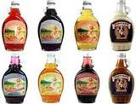
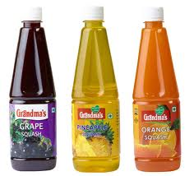
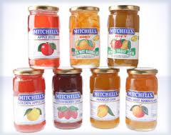
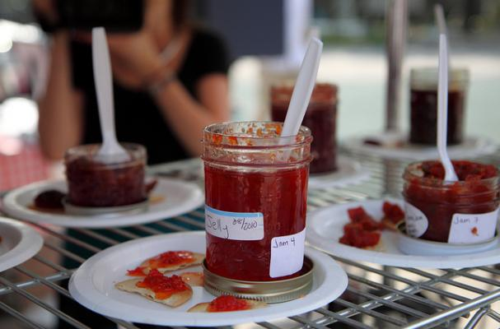
FRUITS AND FRUITS PRODUCTS
Fruit syrups
Minimum% of total solids | Minimum % of fruit juices or prepared fruit
65 | 25
Squashes
Minimum% of total solids | Minimum % of fruit juices or prepared fruit
40 | 25
Fruit preserves
Minimum% of total solids | Minimum % of fruit juices or prepared fruit
68 | 55
Fruit: jams, jellies, marmalades
Minimum% of total solids | Minimum % of fruit juices or prepared fruit
65 | 45
Fruit chutney
Minimum% of total solids | Minimum % of fruit juices or prepared fruit
50 | 40

Slide 22
Candied Fruit / Glazed fruit and peel
Candied Fruit
Candied orange and lemon peels
Total sugar (%) | Reducing sugar (%) of total sugar
Not less than 70 | Not less than 25
TAMARIND CONCENTRATE
- Shall be free from moulds, insect and rodent contamination
Tartaric acid (%) | Ash soluble | Total soluble solids(not more than)
9.0 | 0.8% | 65%

Slide 23
BOTTLED OR CANNED FRUIT
Head space in can – not more than 1.6cm
Drained weight – not less than 50%
No artificial colour.
No positive pressure.
No sign of bacterial growth when incubated at 37oC for 1 week
BOTTLED OR CANNED VEGETABLE
Head space in can – not more than 1.6cm
Drained weight – not less than 55%
No artificial colour.
No positive pressure.
No sign of bacterial growth when incubated at 37oC for 1 week

Slide 24
TOMATO PRODUCTS
Min.%-total soluble solids free of salt | Mould count(not in excess of)
Juice – 5 Soup – 7 | 30%
tomato juice
Tomato Soup
Min.%-total soluble solids free of salt | Mould count(not in excess of)
Paste – 25 Puree – 9 | 60%
Min.%-total soluble solids free of salt | (not in excess of) Mould count - 40% Yeast – 125 per 1/60c.mm Bacteria-100million/ml
25 Min. acidity -1%
Tomato paste
tomato puree
tomato ketchup
Min.%-total soluble solids free of salt | (not in excess of),Mould count - 40%,Yeast – 125 per 1/60c.mm Bacteria-100million/ml
15 (Min.acidity – 1.2%
Tomato Sauce

Slide 25
MILK
Cow’s milk/Buffalo’s milk/combination.
Milk fat – 4.5%; Milk solids non –fat – 8.5%
(abstraction/add. of milk fat/add. of skimmed milk/add.of recombined /reconstituted skimmed milk).
Shall be pasteurized.
Show a negative Phosphatase test.
Recombined Milk
Homogenised product prepared from milk fat, non-fat milk solids and water.
Shall be pasteurized.
Show a negative Phosphatase test.
Milk fat – 3.0; Milk solids non-fat – 8.5
Mixture of cow’s/buffalo milk /both with skimmed milk
Mixture of cow’s/buffalo milk /both with non-fat milk solids or milk powder, or water.
Partial abstraction/addition of fat from / to milk.
Shall be pasteurized.
Show a negative Phosphatase test.
Milk fat – 3.0; Milk solids non-fat – 8.5

Slide 26
DOUBLE TONED MILK
Mixture of cow’s/buffalo milk /both with non-fat milk solids or milk powder, or water.
Partial abstraction/addition of fat from / to milk.
Shall be pasteurized.
Show a negative Phosphatase test.
Milk fat – 1.5; Milk solids non-fat – 9.0
SKIMMED MILK
Almost all the milk fat has been removed
Milk fat – not more than 0.5; Milk solids non-fat – 8.7

Slide 27
Cream
MILK PRODUCTS
Product of cow’s/buffalo milk/both.
Contains not less than 25% milk fat.
Malai
Prepared by boiling and cooling cow’s/buffalo milk/both.
Contains not less than 25% milk fat.
Dahi
Product obtained from pasteurized /boiled milk by souring.
May contain cane sugar.
Minimum %age of milk fat and milk solids non fat.

Slide 28
Paneer
Product of cow’s/buffalo milk/both by precipitation with sour milk or lactic acid or citric acid.
Moisture – not more than 70%
Milk fat – not less than 50%
Skim milk Paneer
Product of cow’s/buffalo skim milk/both by precipitation with sour milk or lactic acid or citric acid.
Moisture – not more than 70%
Milk fat – not less than 13%
Cheese
Product obtained by draining after coagulation of milk with an agent.
It contains coagulating agent, NaCl, CaCl2 – not exceeding 0.02%
Annatto, emulsifiers, stabilizers, sodium citrate, ortho phosphoric acid and polyphosphoric acid- not exceeding 0.2%
Wax used for covering – not harmful.
Colours – Permitted colours.

Slide 29
khoa
Product obtained from cow’s/buffalo/goat/sheep milk/combination by rapid drying.
Milk fat – not less than 20%.
ice cream
Kulfi
Kulfa
Frozen product obtained from cow’s/buffalo milk /combination.
With/ without cane sugar, eggs, fruits, fruit juices, preserved fruits, nuts, chocolate, edible flavours, permitted food colours.
Permitted emulisifiers and stabilizers – not exceeding 0.5%.
Milk fat – not less than 10% ; Protein – 3.5%; total solids – 36%

Slide 30
Evaporated Milk (Condensed milk unsweetened)
Product obtained from cow’s /buffalo milk / combination/standardised milk by partial removal of water.
May contain calcium chloride, citric acid and sodium citrate, sodium salts of ortho phosphoric acid and polyphosphoric acid – not exceeding 0.3%.
Milk fat – not less than 8%: Milk solids – not less than 26%.
Condensed milk sweetened
Product obtained from cow’s /buffalo milk / combination/standardised milk by partial removal of water and after addition of sugar.
May contain added refined lactose, calcium chloride, citric acid and sodium citrate, sodium salts of ortho phosphoric acid and polyphosphoric acid – not exceeding 0.3%.
Milk fat – not less than 9%: Milk solids – not less than 31%; cane sugar – not less than 40%.

Slide 31
Condensed skimmed milk unsweetened
Product obtained from cow’s /buffalo skim milk / combination by partial removal of water.
May contain calcium chloride, citric acid and sodium citrate, sodium salts of ortho phosphoric acid and polyphosphoric acid – not exceeding 0.3%.
Milk fat – not exceed than 0.5%: Milk solids – not less than 20%.
Condensed skimmed milk sweetened
Product obtained from cow’s /buffalo skim milk / combination/ standardised milk by partial removal of water and after addition of sugar.
May contain added refined lactose, calcium chloride, citric acid and sodium citrate, sodium salts of ortho phosphoric acid and polyphosphoric acid – not exceeding 0.3%.
Milk fat – not exceedthan 9%: Milk solids – not less than 26%;
cane sugar – not less than 40%.

Slide 32
MILK POWDER
Product obtained from cow’s /buffalo milk / combination/standardised milk by removal of water.
May contain calcium chloride, citric acid and sodium citrate, sodium salts of ortho phosphoric acid and polyphosphoric acid – not exceeding 0.3% and 0.01% butylated hydroxyanisole.
Milk fat – not less than 26%: Moisture– not more than 5%.
Skimmed Milk Powder
Product obtained from cow’s /buffalo skimmed milk / combination/standardised milk by removal of water.
May contain calcium chloride, citric acid and sodium citrate, sodium salts of ortho phosphoric acid and polyphosphoric acid – not exceeding 0.3%.
Milk fat – not more than 1.5%: Moisture– not more than 5%.

Slide 33
Infant Milk Food
Product obtained by drying cow’s /buffalo milk / combination/standardised milk with addition of specific carbohydrates(cane sugar, dextrose and dextrins, maltose or lactose) iron salts and vitamins.
Free from starch and antioxidants.
Moisture – not more than 5%; milk fat –18% to 28%.
Total carbohydrates – not less than 35%.
Milk protein – not less than 20%; Total ash – not more than8.5%;
Ash insoluble in dil.HCl – not morethan 0.01%
Iron -4mg/100gm; Vitamin A – not less than 15 I.U.
Table Butter
Product obtained by drying cow’s /buffalo milk / combination/cream /curd with or without addition of salt, annatto.
Free from other animal fats, wax and mineral oils, vegetable oils and fats.
Milk fat –not less than 80%;
Diacetyl may be added as a flavouring agent(not exceed 4ppm)
Calcium hydroxide, sodium bicarbonate, sodium carbonate, sodium polyphosphates may added (not exceeding 0.2%)for regulating the hydrogen ion concentration,

