Slide 1
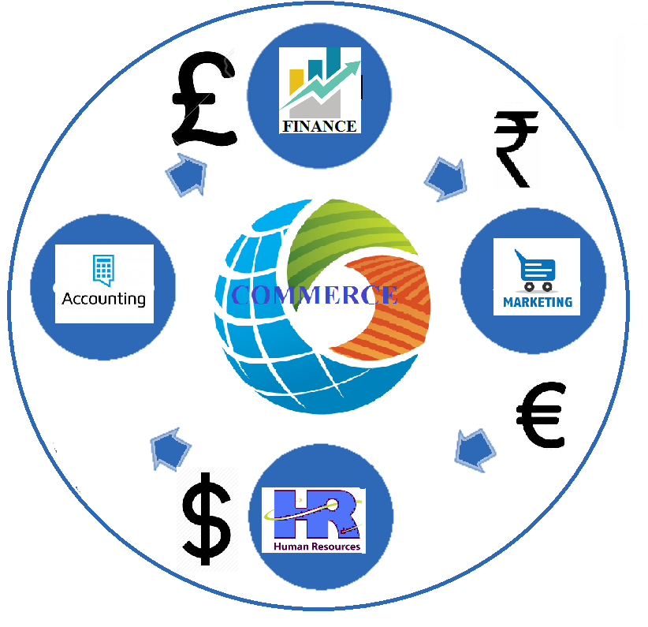
“My SRC, My Pride”
PG and Research Department Of Commerce

Slide 2
MARKETING MANAGEMENT
PROMOTION AND COMMUNICATION
By
Dr.R.Lalitha
PG and Research Department of Commerce
Seethalakshmi Ramaswami College (Autonomous)
Tiruchirappalli-620 002

Slide 3
PROMOTION
Promotion is the element in an organisation’s marketing mix that serves to inform, persuade and remind the market about the organisation and/or its products.

Slide 4
Promotional Mix
Personal selling: the presentation of a product to a prospective customer by a firm’s sales executive.
Advertising: paid, non-personal mass communication, in which the sponsor is clearly identified.
Sales promotion: demand-stimulating activity designed to supplement advertising and co-ordinate personal selling.
Publicity: a non-paid form of advertising that uses mass communication to stimulate demand.

Slide 5
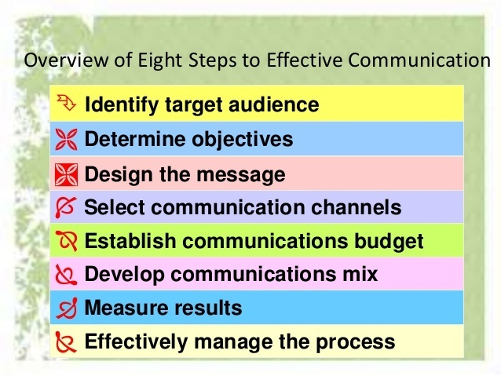

Slide 6
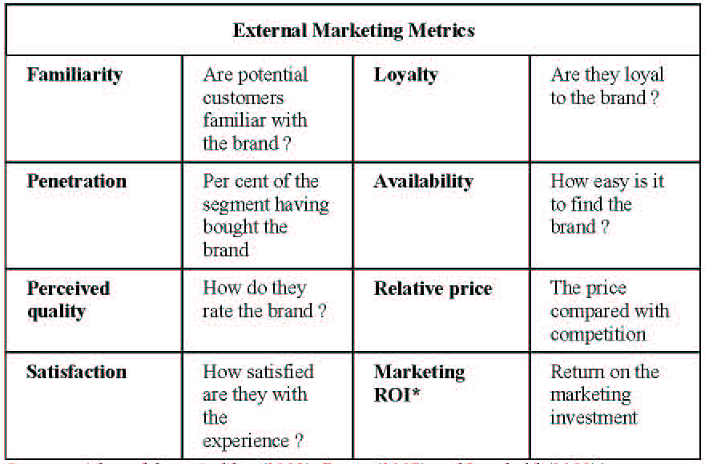
1.IDENTIFY THE TARGET AUDIENCE:
a. Familiarity Analysis

Slide 7
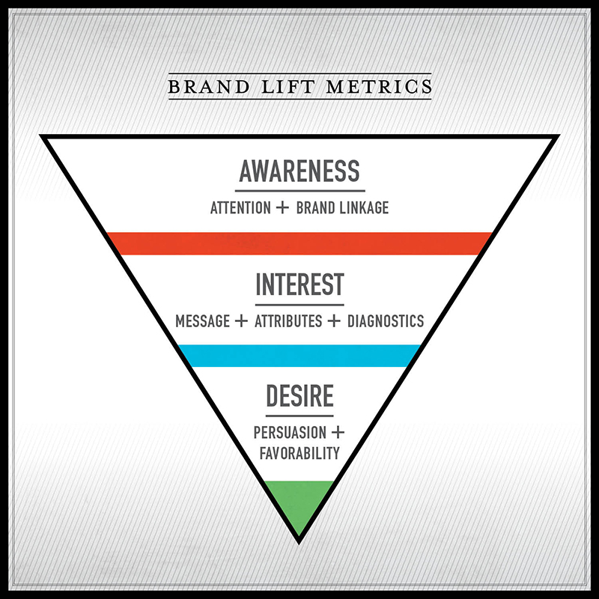
b. Favorability Analysis

Slide 8
KNOWERS |  | NON-KNOWERS
TRIERS | PREFERERS
 | INDIFFERENTS
 | REJECTORS
NON-TRIERS

Slide 9
2. DETERMINE THE COMMUNICATION

Slide 10
DESIGN THE MESSAGE:
1.MESSAGE CONTENT
2.MESSAGE STRUCTURE:
(CONCLUSION, ARGUMENT,PRESENTATION)
3.MESSAGE FORMAT:
(PRINT, AUDIO VISUAL, AUDIO)
4.MESSAGE SOURCE

Slide 11
SELECT THE COMMUNICATION CHANNELS
1.Personal Communications
(ADVOCATE, EXPERT, SOCIAL)
2.Non-personal Communications
(MASS, SELECTIVE, ELECTRONIC, DISPLAY MEDIAS)

Slide 12
DECIDING PROMOTION BUDGET
Affordable Method
Percentage Of Sales Method
Competitive Method
Objective And Task Method
(Sales Response or Decay)
Historical Method

Slide 13
Percentage of sales method
Company may determine past or anticipated sales and apply a percentage of sales as the promotional budget.
Affordable Method
Company uses all available funds on the promotional campaign .
Competitive Parity Method
Promotional expenditure based on market share of competitors, or actual expenditure if known.
Task or Objective Method
Determine what tasks or objectives the promotion must accomplish.
Determine what it will cost to perform the task or meet objective.

Slide 14
DECIDING THE PROMOTION MIX
1.Types and nature of product
(Industry And Consumer Product)
2.Strategy to be followed
(Push And Pull Strategy)
3.Buyer Readiness Stage
4.Product Life Cycle Stage
(Introduction, Growth, Maturity, Decline)

Slide 15
Nature and Type of the Product
Consumer or Industrial product.
Unit Value of the Product.
Amount of product customisation.
Amount of pre-sale and post-sale service required.

Slide 16
PUSH Vs PULL STRATEGY
Push Strategy
Producer
Wholesaler
Retailer
Consumer
Pull Strategy
Producer
Wholesaler
Retailer
Consumer
Product flow
Promotion effort
9-10

Slide 17
Determine customer’s readiness to buy.
Awareness
Knowledge
Liking
Preference
Conviction
Purchase

Slide 18
Product Life Cycle
Introduction
Growth
Maturity
Saturation
Decline

Slide 19
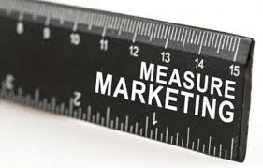
MEASURING THE PROMOTIONS RESULTS
Recognizing Test
Recall Test

Slide 20
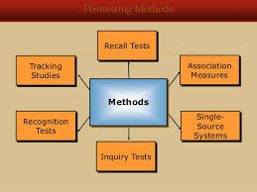

Slide 21
MANAGING & COORDINATING MARKETING PRESSURES
Appoint the marketing common director.
Determine his role, responsibility.
Coordinate the activities.

Slide 23
Thank you

